Slide 1
Assignment5

Slide 2
Write a program for a network according to the following figure, where n₀ node is connected to n₄ by TCP and n₁ node is connected to n₅ by UDP. Nodes n_{3,} n_{4,} & n₅ are put on a common LAN. This means that TCP packets destinated to node n₄ arrive also at node n₅ , TCP ack sent by node n₄ to node n₀ also arrive at node n₅, and UDP packets destinated to node n₅ also arrive at node n₄.
The LAN having the following characteristic: (i) n_{3,} n_{4,} & n₅ group of nodes, (ii) 0.5Mb bandwidth, (iii) 40ms delay, (iv) LL type link layer, (v) Drop tail queue interference, & (vi) Csma/Cd MAC type.

Slide 3
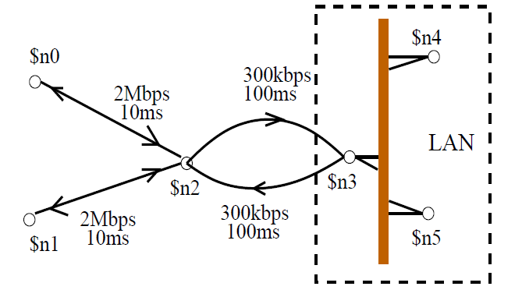
Calculate the packet sent, received, & dropped for each link between nodes in the network. Create the output trace files for each link in the network & also a overall trace file for the whole network.

Slide 4
2. Create N no. of wireless nodes, such as n(i), i={1,2,…,20}. There exist a link l(i,j) between n(i) and n(j), where distance dis(n(i),n(j)) <= Transmission range (T_{r}). Create a distance trace file of N=20 nodes, which contains distance of each node n(i) from node n(j). The nodes n(i) and n(j) are two neighbors, if l(i,j) is exist between them. The node n(j) is also called as neighbor of n(i), i.e. (neg(ni)). Compute the neighbor list of each node n(i) and print the neighbor list of each node in the wireless network. Sensor nodes are homogeneous in nature, and transmission range is 150m.

